Slide 1

Opening a new restaurant in Manhattan
Dec.
2020

Slide 2

The restaurant industry is essential to New York City’s social and economic fabric. From small, family-owned restaurants and food carts to four-star world-famous establishments, the City abounds with restaurants that offer cuisines from every corner of the globe.

Slide 3

Restaurants lend vitality to each neighborhood and are integral to Manhattan’s central business districts and the City’s vibrant tourism industry, attracting millions of visitors each year who spend a total of $46 billion annually.

Slide 4
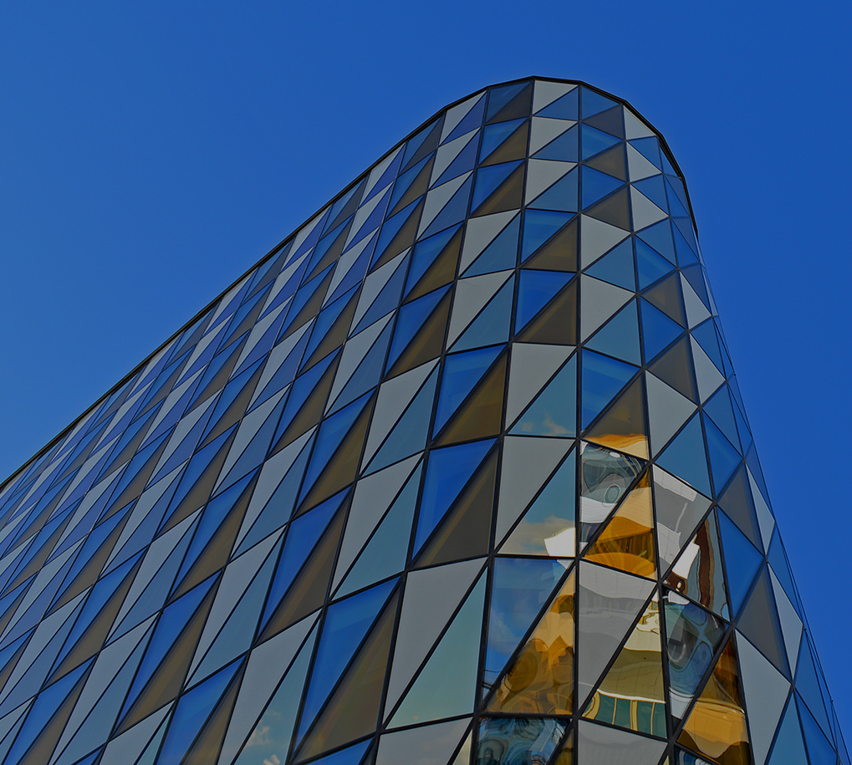
New York City’s restaurant industry had 23,650 establishments in 2019, provided 317,800 jobs, paid $10.7 billion in total wages citywide, and made nearly $27 billion in taxable sales.

Slide 5
In Manhattan, most establishments and jobs are in Midtown and Lower Manhattan. The Chelsea/ Clinton/Midtown Business District, which includes the New York City Theater District, had the highest restaurant employment among all the City’s 55 Census-defined neighborhoods (nearly one in four jobs citywide). Battery Park City/Greenwich Village/Soho had the second-highest restaurant employment.
The New York City restaurant industry accounted for about 1 in 12 private sector jobs and establishments citywide in 2019 .
Most restaurants and bars are small and reflect great diversity. In New York City, 80 percent have fewer than 20 employees.

Slide 6
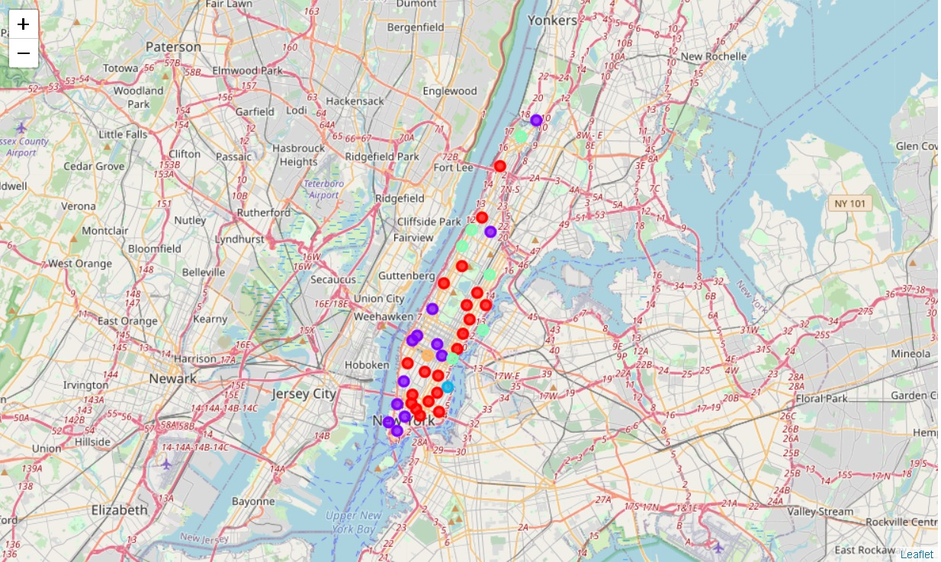
Clusters of Manhattan

Slide 7


Two of the most promising clusters are cluster two and four.

Slide 8

Conclusion
Most of restaurants are concentrated in the lower and central area of Manhattan, in the cluster 0 and cluster 1. On the other hand, cluster 2 and cluster 4 has few restaurants at all. This represents a great opportunity and high potential areas to open new restaurants anywhere in cluster 2 and 4, as there is little competition from existing restaurants. Meanwhile, restaurants in cluster 0 and cluster 1 are likely suffering from intense competition due to oversupply and high concentration of restaurants. From another perspective, this also shows that the oversupply of restaurants mostly happened in the central area of the city. Therefore, this project recommends property developers to capitalize on these findings to open new restaurants in neighborhoods in cluster 2 or cluster 4 with little competition.

Slide 9

THANK
YOU!

